Slide 2
BONE
Dr Iram Tassaduq

Slide 3
DEFINITION
Bone is a specialized connective tissue characterized by mineralized extracellular matrix.
Bones are the organs of skeletal system; bone tissue is the structural component of bones.

Slide 4
FUNCTIONS
Support
Protection
Movement
Production of blood cells
Storage of minerals

Slide 5
CHARACTERISTICS
Consists of cells and extracellular matrix.
Bones are covered by periosteumm
Bone cavities contain red bone marrow

Slide 6
PERIOSTEUM
a layer of dense connective tissue surrounding the bone

Slide 8
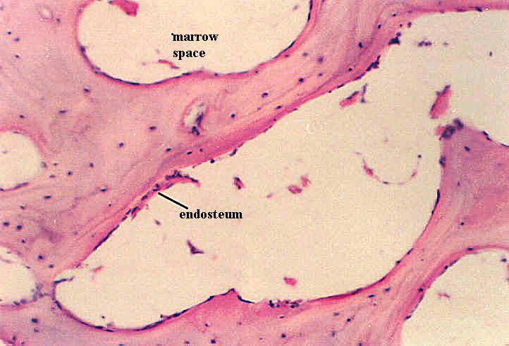
ENDOSTEUM
A thin layer of cell-rich connective tissue, the endosteum, lines the surface of the bone facing the marrow cavity. Both the periosteum and the endosteum possess osteogenic potency.

Slide 9
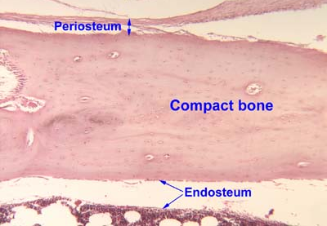

Slide 10
BONE MATRIX
90% Collagen fibers
Type 1, Type 3, Type 5, Type11, Type13
10% protein
1. Proteoglycans
2. Multiadhesive glycopoteins
3. Bone specific vitamin k dependent proteins
4. Growth factors and cytokines

Slide 11
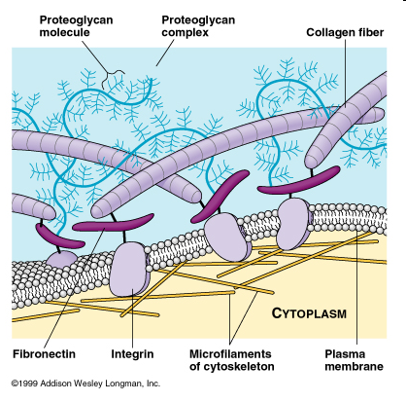

Slide 12
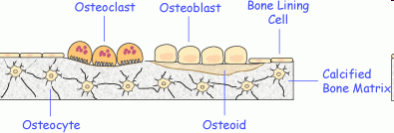
BONE CELLS
1.Osteocytes
2.Osteoblasts
3. Bone-lining cells
4 Osteoclasts

Slide 13
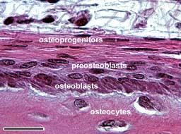
OSTEOPROGENITOR CELLS
Located in the periosteum and endosteum.Flat squamous cells. They are very difficult to distinguish from the surrounding connective tissue cells.

Slide 14
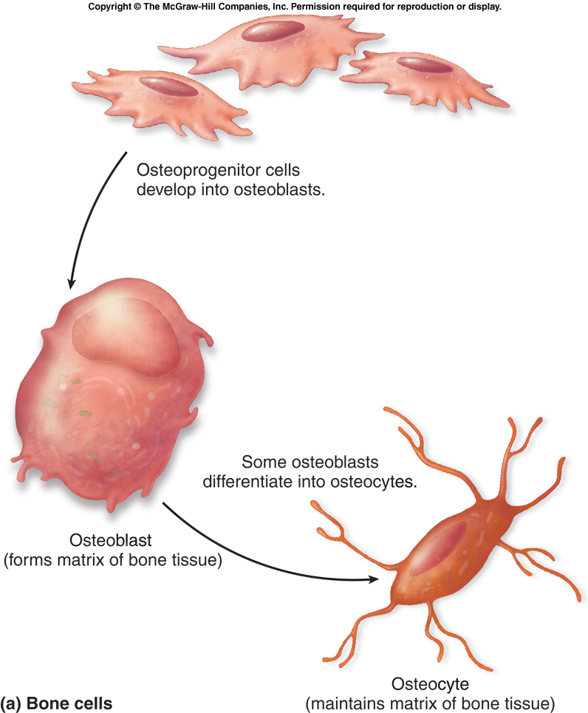
OSTEOBLASTS
Osteoblasts may form a low columnar "epitheloid layer" at sites of bone deposition.
They contain plenty of rough endoplasmaic reticulum (collagen synthesis) and a large Golgi apparatus
Responsible for bone calcification

Slide 15
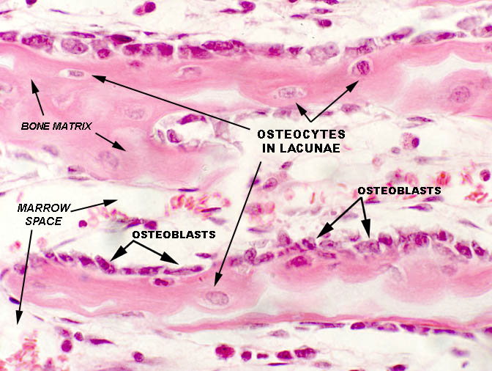

Slide 16
Osteocytes
Mature bone cells.
Stellate.
Surrounded by matrix,
can make small amounts of matrix to maintain it.

Slide 17
Lacunae: spaces occupied by osteocyte cell body
Canaliculi: canals occupied by osteocyte cell processes
Nutrients diffuse through tiny amount of liquid surrounding cell and filling lacunae and canaliculi. Then can transfer nutrients from one cell to the next through gap junctions.

Slide 18
STATES OF OSTEOCYTES
Quiescent osteocytes
Formative osteocytes
Resorptive osteocytes

Slide 19
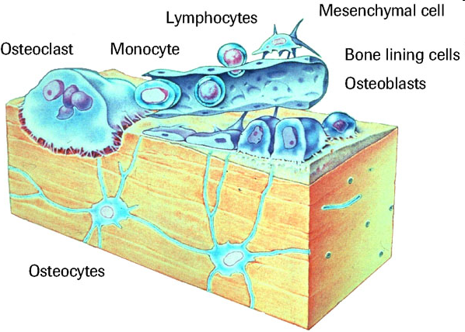
BONE LINING CELLS
On external surface are called periosteal cells
On internal surface are called endosteal cells
Maintenance and nutritional support of osteocytes

Slide 20
OSTEOCLASTS
Large multi-nucleated bone-resorbing cells.. Osteoclasts attach themselves to the bone matrix (howships lacunae) and form a tight seal at the rim of the attachment site.
Osteoclasts are stimulated by parathyroid hormone and inhibited by calcitonin

Slide 21
The cell membrane opposite the matrix has deep invaginations forming a ruffled border. Osteoclasts empty the contents of lysosomes into the extracellular space between the ruffled border and the bone matrix. The released enzymes break down the collagen fibres of the matrix.

Slide 22
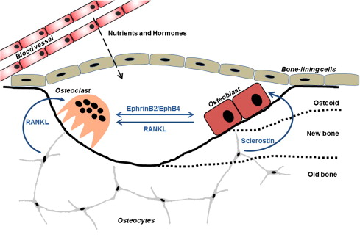

Slide 23
CLASSIFICATION OF BONES
Compact Bone
Cancellous (Spongy) Bone

Slide 24
COMPACT BONE
Central or Haversian canals: parallel to long axis
Lamellae: concentric, circumferential, interstitial

Slide 25
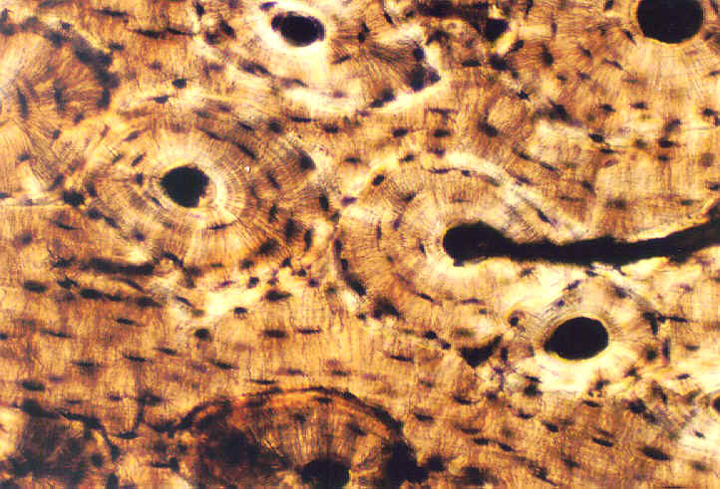

Slide 26
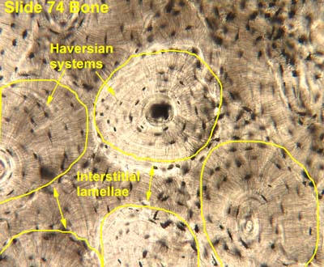

Slide 27
Circumferential lamellae on the periphery of a bone
Interstitial lamellae between osteons

Slide 28
COMPACT BONE
Osteon or Haversian system: central canal, contents, associated concentric lamellae and osteocytes

Slide 30
PERFORATING OR VOLKMANN’S CANAL
perpendicular to long axis. Both perforating and central canals contain blood vessels. Direct flow of nutrients from vessels through cell processes of osteoblasts and from one cell to the next.

Slide 31
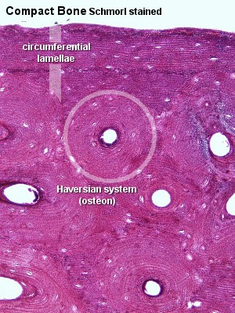
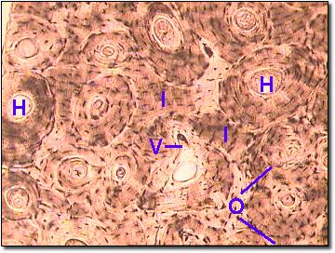

Slide 33
CANCELLOUS (SPONGY) BONE
Trabeculae: interconnecting rods or plates of bone. Like scaffolding.
Spaces filled with marrow.
Covered with endosteum.
Oriented along stress lines

Slide 34
