Slide 1
DECAYED missing filled index (DMF)

Slide 2
DMFT Index
Was introduced by Henry Klien, Carrole E.Palmer and Knutson J.W in 1938

Slide 3
Method
Applied to permanent teeth
D…………..decayed teeth
M…………..missing due to caries
F…………….previously filled teeth

Slide 4
Method
All the 28 teeth are examined
The teeth that are not included are:
-Third molars
- Un-erupted teeth
- Congenitally missing
- Supernumerary
-Teeth removed for any other reason than caries
- Teeth restored for any other reason other than caries example…..trauma or cosmetic purposes
- primary tooth retained with the permanent successor erupted

Slide 5
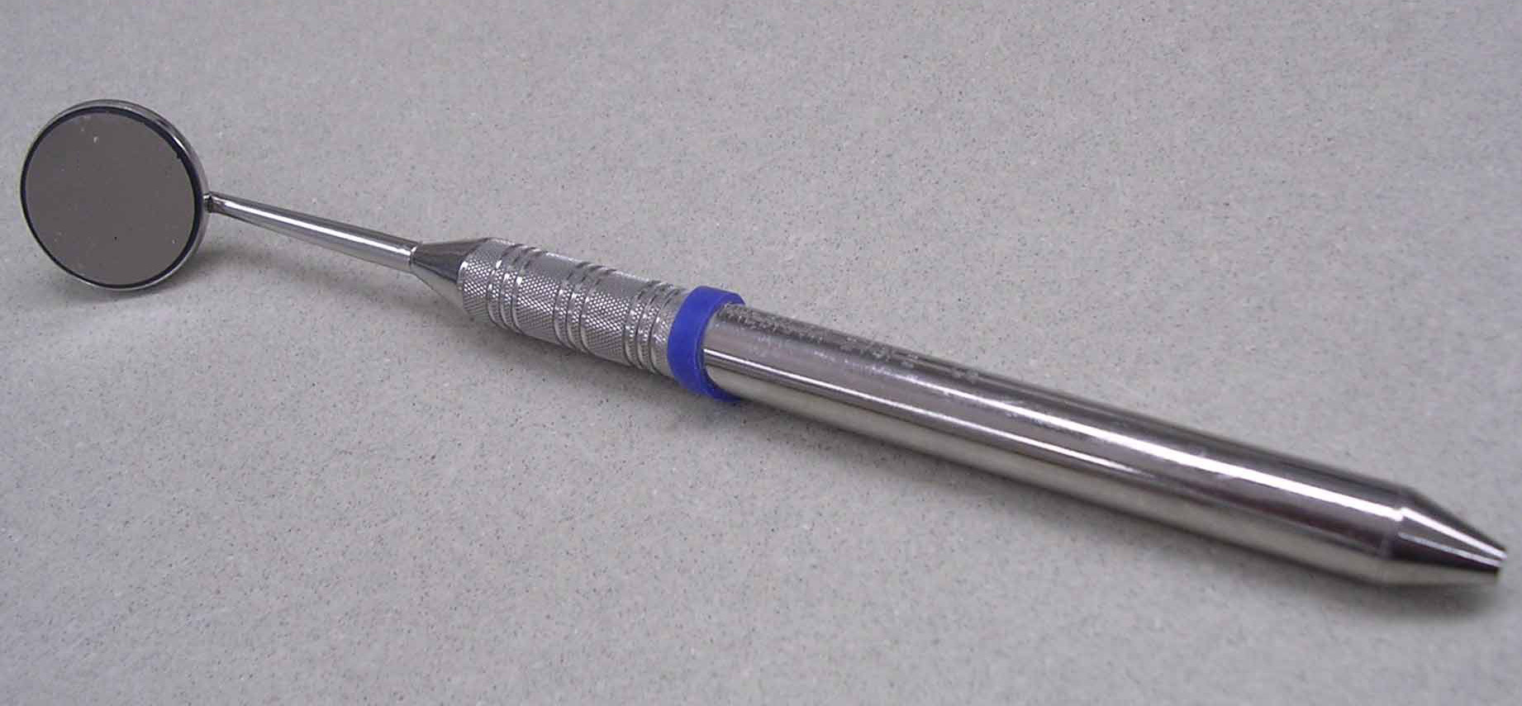
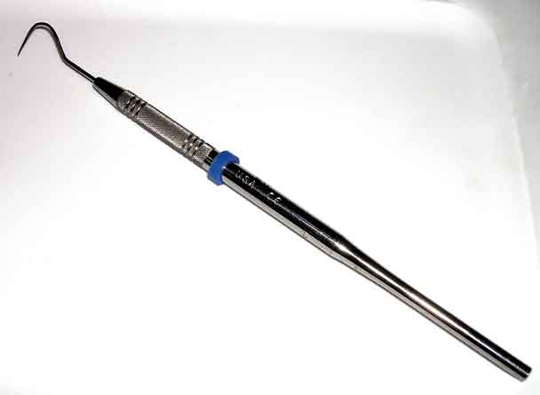
Instruments

Slide 6
Criteria for the Identification of Caries
Lesion is clinically visible
Explorer tip can penetrate deep into soft yielding material
There is discoloration or loss of translucency
The explorer tip in a pit or fissure catches or resists removal after pressure on insertion

Slide 7
Principles & Rules

Slide 8
Principles & Rules
No tooth is counted more than once
D, M or F teeth should be recorded separately
When counting the decayed teeth, also count those teeth which have restorations with recurrent decay
Care must be taken to list the missing teeth
A tooth may have many restorations but is counted as ONE
Deciduous teeth are not included
A tooth is considered to be erupted when the occlusal surface or incisal edge is totally exposed or can be exposed be gently reflecting the gingival tissue

Slide 9
WHO modifications

Slide 10
WHO Modification
All third molars are included
Temporary restorations are considered as D
Only carious cavities are considered as D, initial lesions ( chalky spots, stained fissures) are not considered

Slide 11
Examination method For Permanent teeth only

Slide 12
D
Indicates the no of permanent teeth that are decayed
Remember that a tooth can be counted only once
Cannot be counted as decayed and filled

Slide 13
M
Indicated the no of missing permanent teeth due to decay
The teeth which are badly decayed that they are advised for extraction are counted as missing
History must be taken to identify that teeth have been lost due to caries

Slide 14
F
Indicates the no of permanent teeth that have been attacked by the caries, and now restored fully and functionally good
Tooth may have several filling fillings but is counted as ONE

Slide 15
Calculation of index

Slide 16
1:Individual DMFT
Identify each component separately
Add each component separately than add all subgroups.
Then add them
D+M+F = DMFT

Slide 17
2:Group Average
Total D, M ,F for each individual , then divide the total DMF by the no of individuals in the group i.e
Average DMFT= total DMFT
total no of persons

Slide 18
Limitations

Slide 19
Limitations
Don’t indicate the no of teeth that are at risk
Can be invalid in older patients because become lost for the reasons other than caries
Can be misleading in children because teeth may be lost for orthodontic reason
Not significant in the root caries

Slide 20
DMFS
Applied only to permanent teeth
D= Decayed teeth surfaces
M= Missing teeth surfaces
F= Filled teeth surfaces

Slide 21
Advantages
More sensitive
Disadvantages
Takes longer time
May require radiographs for accurate assessment.

Slide 22
Surfaces Examined
For Posterior Teeth: Five Surfaces
Facial,Lingual,Mesial,Distal and Occlusal
For Anterior Teeth: Four Surfaces
Facial,Lingual,Mesial,Distal

Slide 23
Calculations
If Third Molars are not included
Total surfaces for posterior teeth= 80
Total Surfaces for anterior teeth =48
Total=128
Rest of the calculations are similar to DMFT index

Slide 24
Caries Indices for Primary Dentition

Slide 25
Def Index
Was Described by Gruebbel A.O in 1944.
d=Decayed Teeth
e= Extracted Teeth ( Due to Caries)
f= Filled Teeth

Slide 26
Calculations of def Index
For Primary teeth maximum def score for an individual would be 20.
Defs score for a child can be 88 to maximum.
Calculations are same as that of DMFT.

Slide 27
For Mixed Dentition
Caries indices for primary and permanent teeth will be calculated separately.
DMFT and deft are never added together.
Index for permanent teeth is calculated first ,followed be deft index.

Slide 28
Plaque Index
Proposed by Silness and Loe
Assessment of thickness of plaque at gingival area.
Four gingival areas( distal, facial, mesial, lingual) for each tooth or selected teeth.

Slide 29
The Plaque Index System Scores
0 Score
No plaque
1 Score
A film of plaque adhering to the free gingival margin and adjacent area of the tooth. The plaque may be seen in only after application of disclosing solution or by using the probe on the tooth surface.
2 Score
Moderate accumulation of soft deposits within the gingival pocket, or the tooth and gingival margin which can be seen with the naked eye.
3 Score
Abundance of soft matter within the gingival pocket and/or on the tooth and gingival margin.

Slide 30
Procedure
Tooth is dried and examined visually
The explorer is passed across the tooth surface near the entrance of gingival sulcus
If no plaque adheres to the explorer it is given score “0” and so on

Slide 31
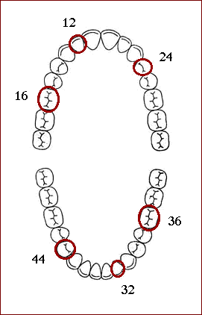
Teeth to be examined

Slide 32
Calculation examples
The following example shows how to calculate the scores for the index.
Assuming a tooth with the following scores on the four surfaces
Surface Scores
Buccal 2
Lingual 1
Mesial 1
Distal 2
Plaque Index = (2+1+1+2) / 4 = 1.5, according to the plaque index system this means the plaque index for the tooth is moderate accumulation of soft deposit within the gingival pocket, or the tooth and gingival margin which can be seen with the naked eye.

Slide 33
For instance, if you have the following indices for the teeth :
Then the index for the patient will be
The index for patient = (1.5 + 1.3 +1.2 + 1 + 1.6 + 1.3) / 6 = 1.4
Tooth | Index
Maxillary right first molar (16) | 1.5
Maxillary right lateral incisor (12) | 1.3
Mandibular left first molar (36) | 1
Mandibular left lateral incisor (32) | 1.6
Mandibular right first bicuspid (44) | 1.3
Maxillary left first bicuspid (24) | 1.2

Slide 34
RATINGS
Excellent (0)
Good (0.1-0.9)
Fair (1.0-1.9)
Poor (2.0-3.0)

Slide 35
Thank You

